Slide 1

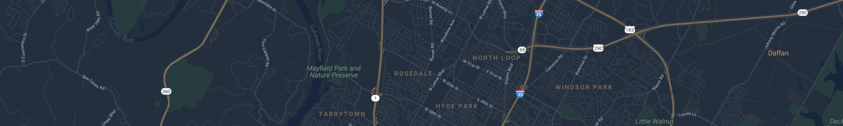
Polaris travel app
Design and Implementation of Mobile Applications
Prof. Luciano Baresi
February 2022

Slide 2
PLAN
EXPLORE
TRAVEL
SHARE
ADD
FRIENDS
GET INSPIRED
COMMENT

Slide 3

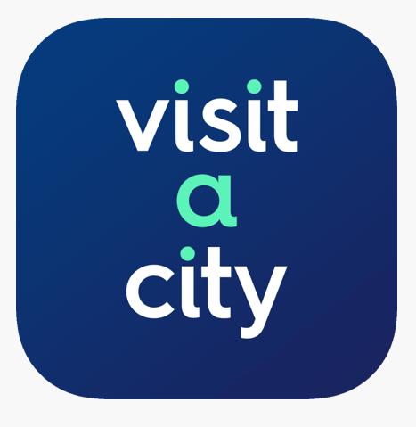



WHY ANOTHER TRAVEL APP?
Booking.com – Used only to book accomodation
Visit A City – Only precreated plans
Triplt – Bad/slow interface, no external APIs, limited free version
Culture Trip – Overly complex, limited trip creation details, focused on premade experiences
Trip Advisor – Lack of social aspect and sharing trips between users

Slide 4
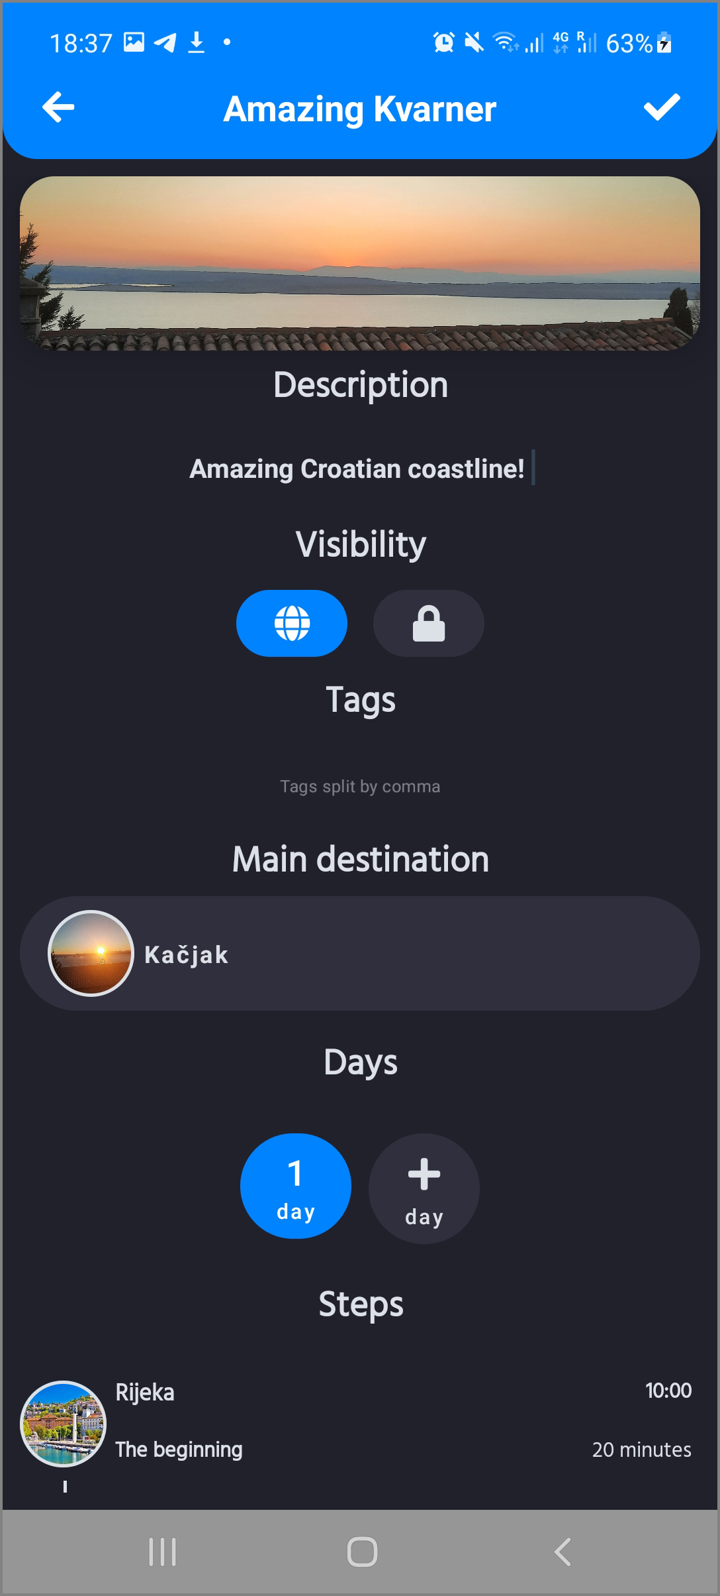
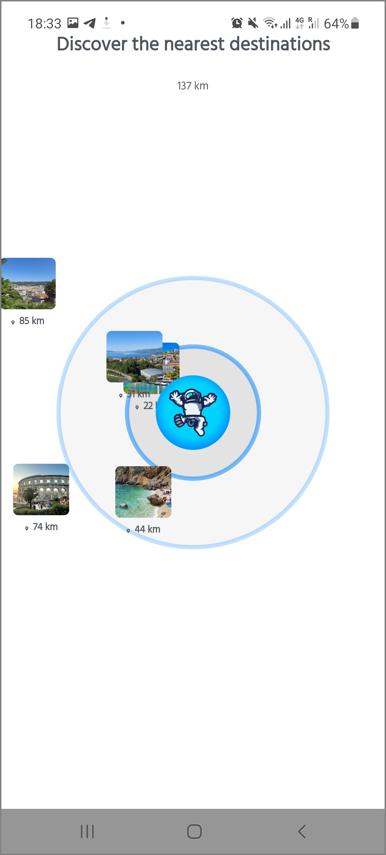
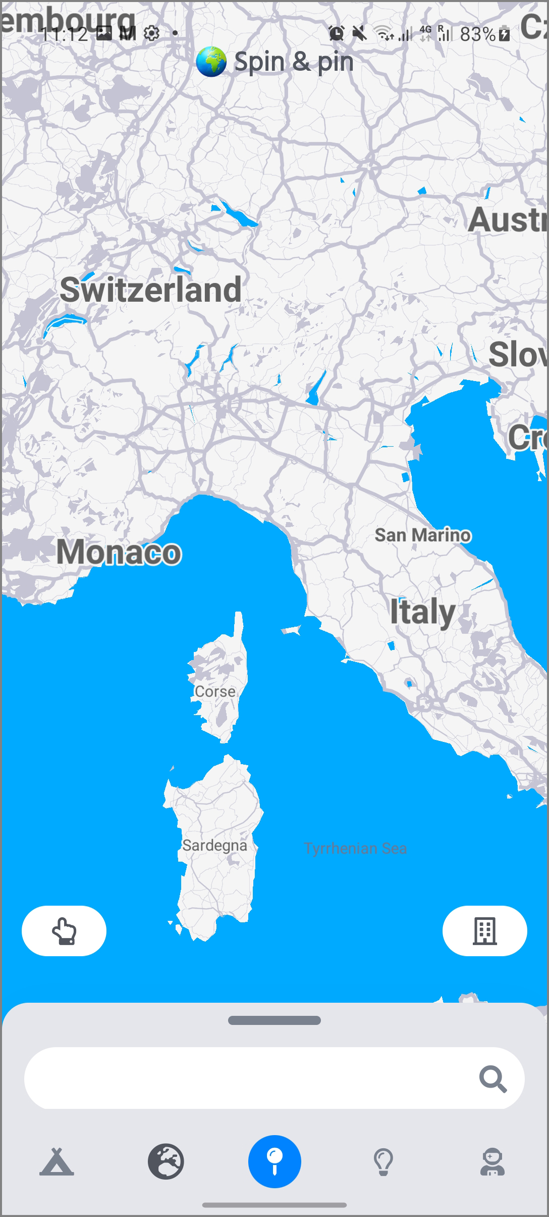
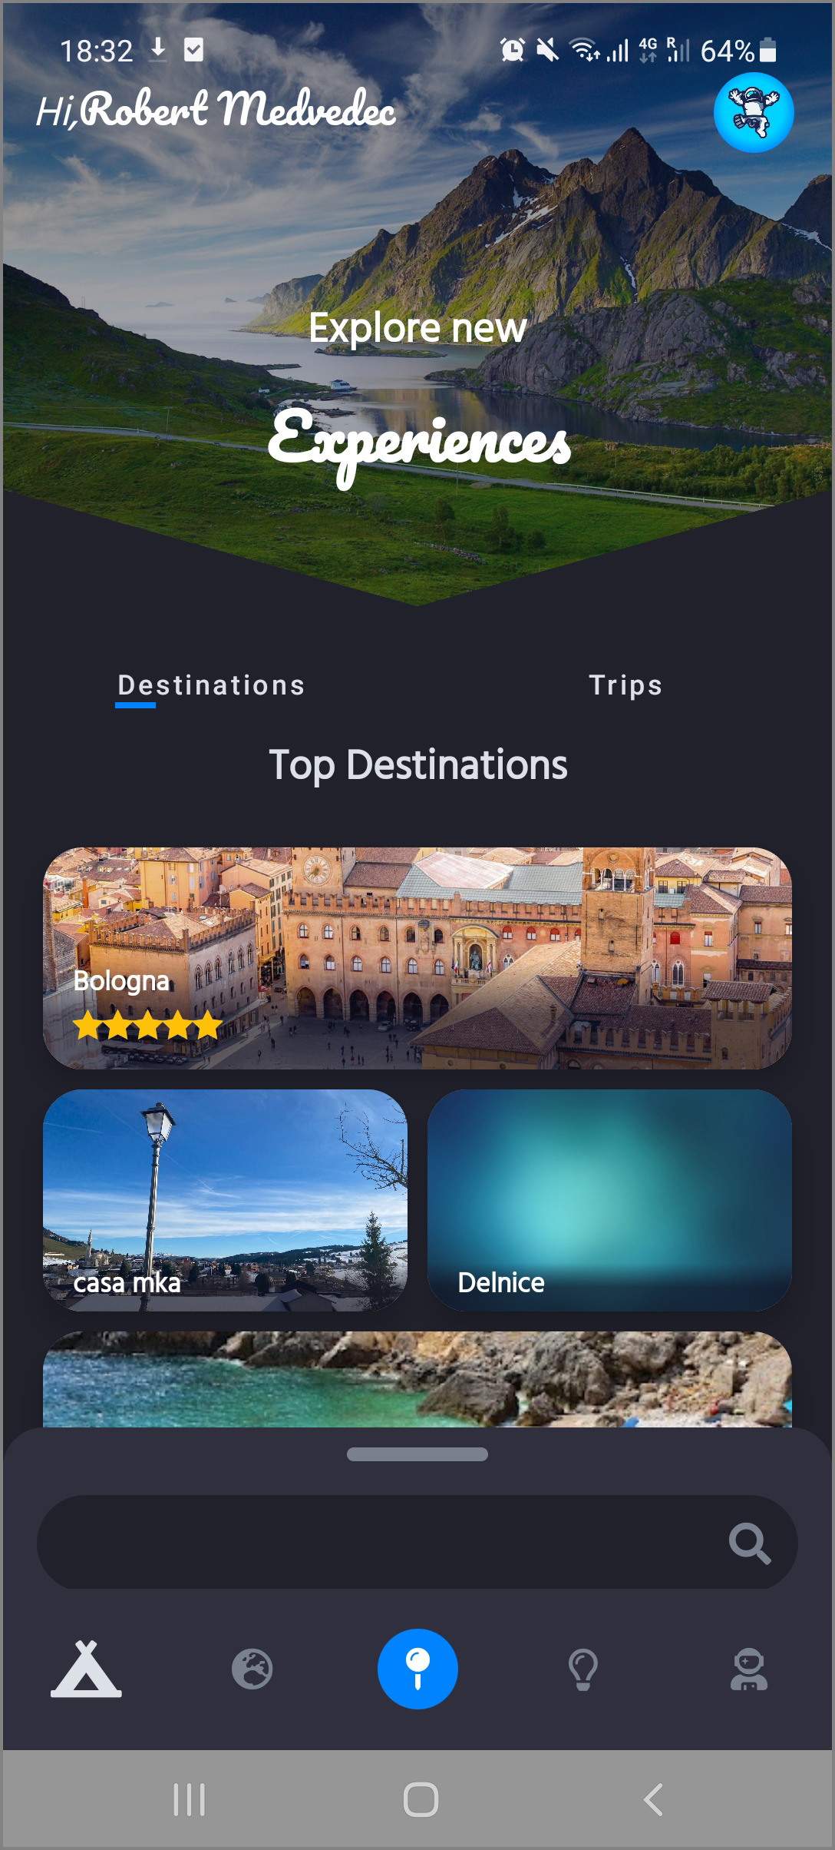
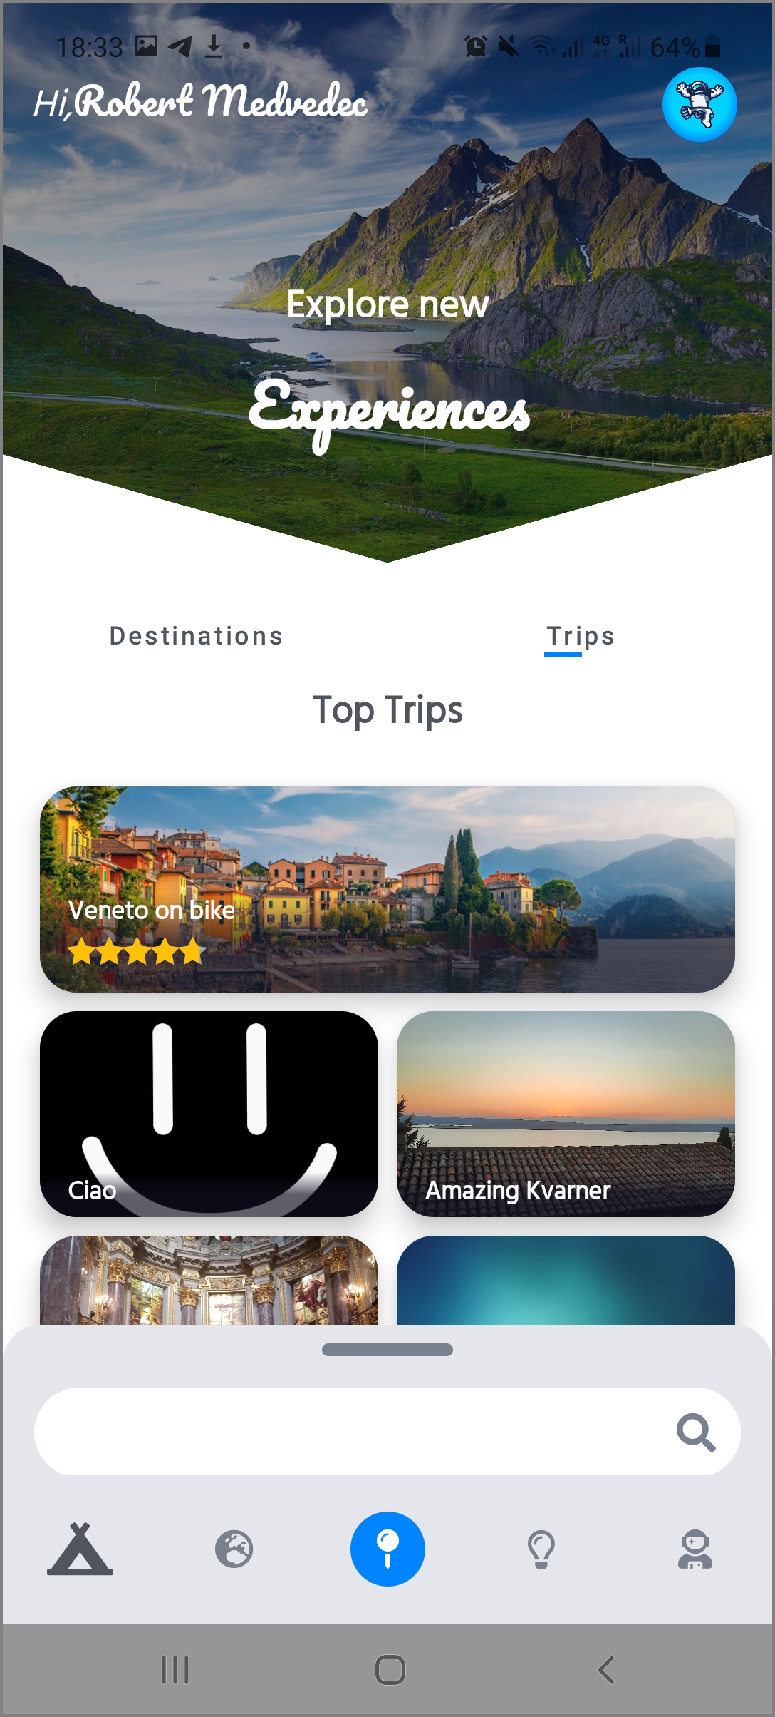
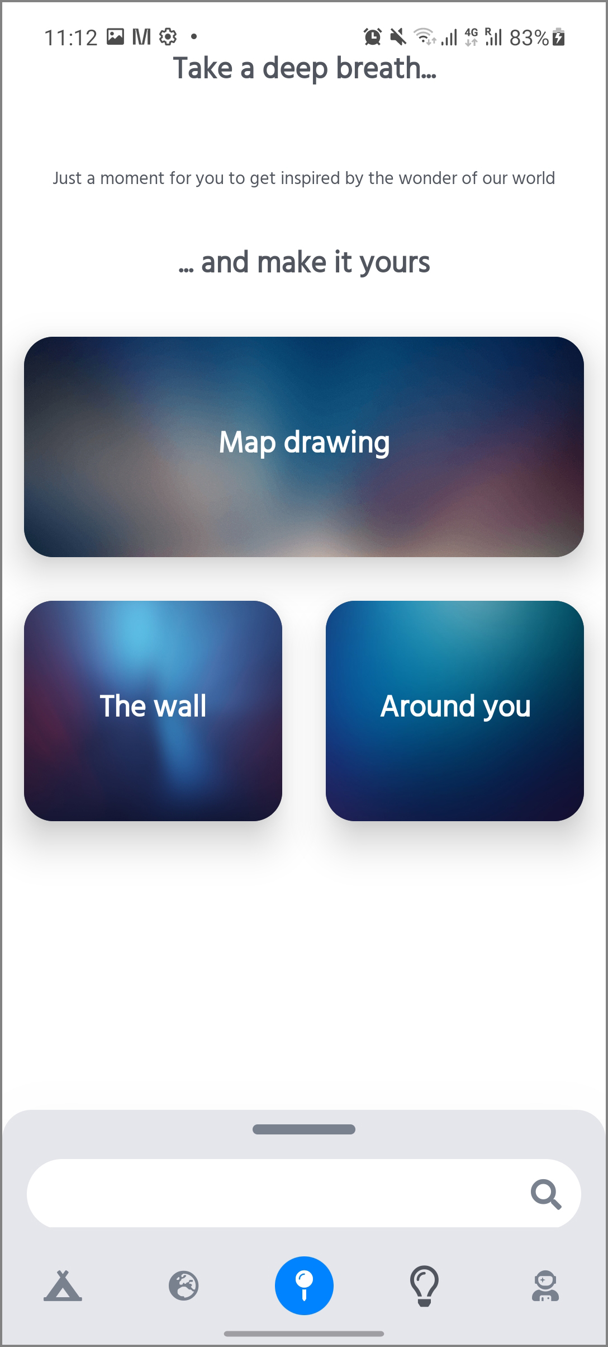
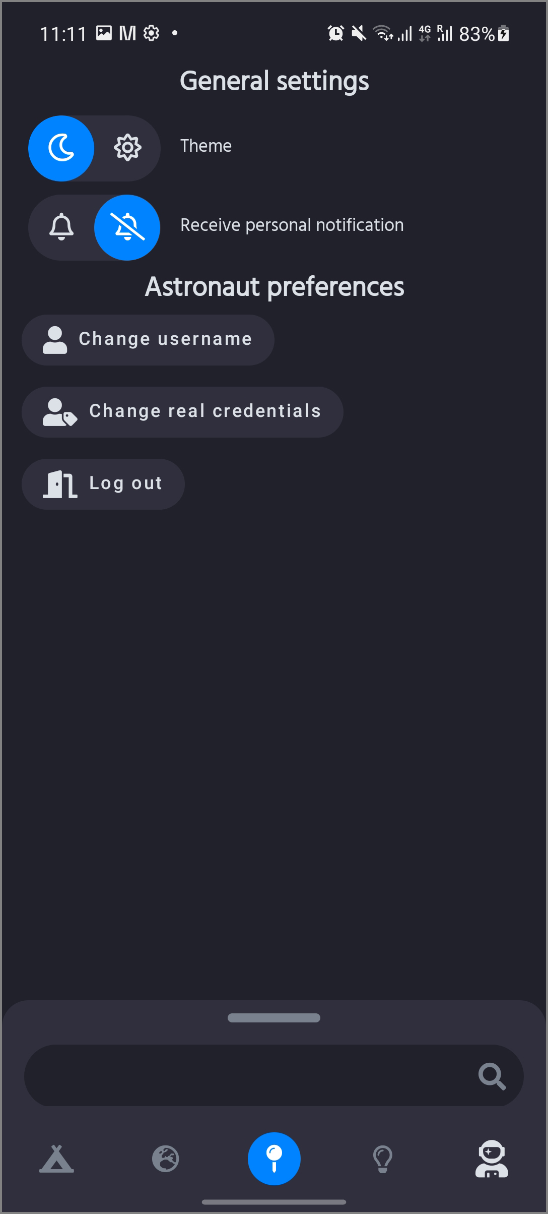

Slide 5

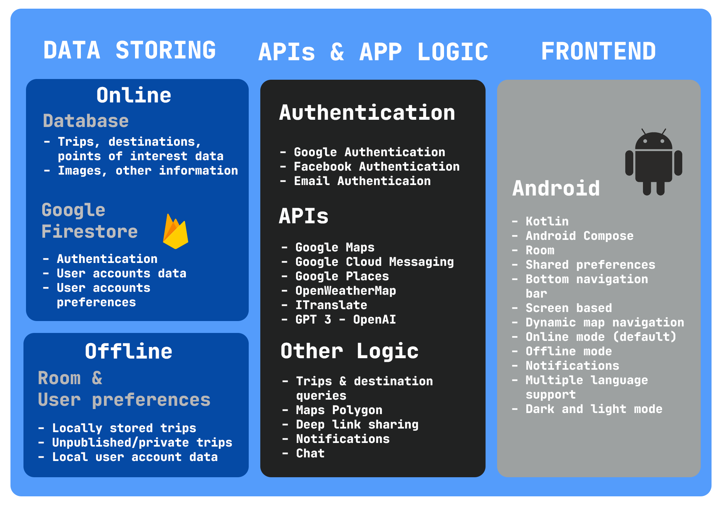

Slide 6
APIs & External services
Google Maps – retrieving locations, map searching, location searching, drawing trip route
Google Cloud Messaging – notifications sending and receiving
Google Places – retrieving places, points of interests, details about museums, restaurants, hotels, etc.
ITranslate – translates destination/trip descriptions and basic info
GPT 3 – completes and interpretes user-generated content
_________________________________________
Deep link sharing – easily shareable trips with a single click
Chat – communication between users regarding trips

Slide 7
ARCHITECTURE - FRONTEND
Model - view – viewmodel architecture (MVVM)
Android Compose models – dynamic drawing and loading of components
Reusable
Lightweight
Direct API access
Easy testing
Combination of composable functions and activities
6 main screens, 7 additional screens
Two different colour palettes
Different composable elements

Slide 8
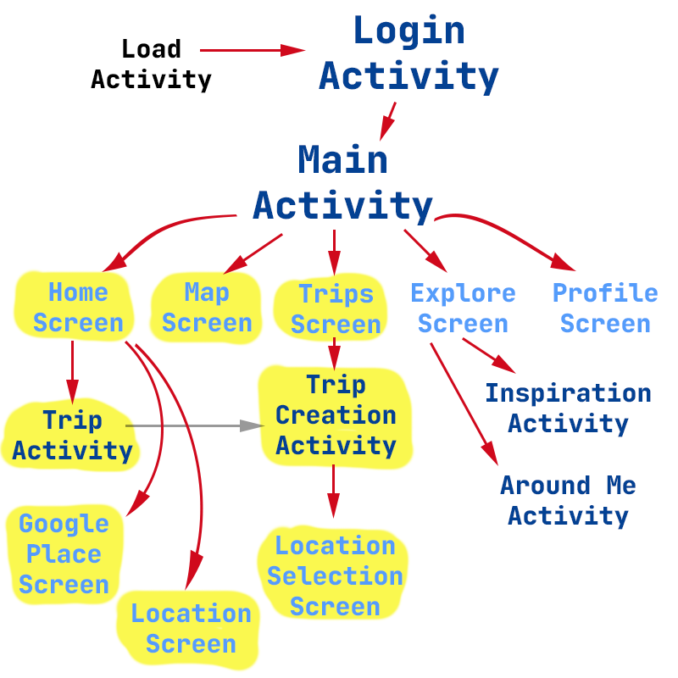
Activities and ComposE screens layout

Slide 9
Middleware & Backend
Authentication – Google, Facebook, Mail
User backend – Firebase Firestore (NoSQL)
Data backend – Server-side database
Local data storing – Android Room
Dynamic data – Google Places and Maps
JSON middleware communication

Slide 10
Testing
Unit testing
Four different components and parts of the system tested
Tests containing large number of functionalities – complete testing
Tested activities/components:
Login testing (7)
Trip creation activity testing (11)
Navigation testing (6)
Map screen testing(5)
Compatibility testing
Different device types and device shapes
7 different devices (4 phones, 3 tablets)
Deep linking testing
Failure testing
Testing the online and offline components
App response when the server is shut down/disabled

Slide 11
LOGIN
TRIP CREATION
NAVIGATION
MAP
Inputting username
Inputting password
Testing login
Testing login with false authentication
Testing login with correct authentication
Logging in with Google account
Logging in with Facebook account
Trip creation
Inputting text to trip name field
Inputting text to trip description field
Inputting multiple tags
Searching destinations with a certain city name
Adding steps
Adding main destinations
Exiting without saving a trip
Exiting with saving a trip (publishing)
Navigation of the bottom tab
Navigation of the home screen
Navigation of the map screen
Navigation of the trip screen
Navigation of the explore screen
Navigation of the profile screen
Navigation to tab
Polygon drawing in the map tab
Retrieving results of the drawn polygon
Selection of the shown destination
Detail display of the destination

Slide 12

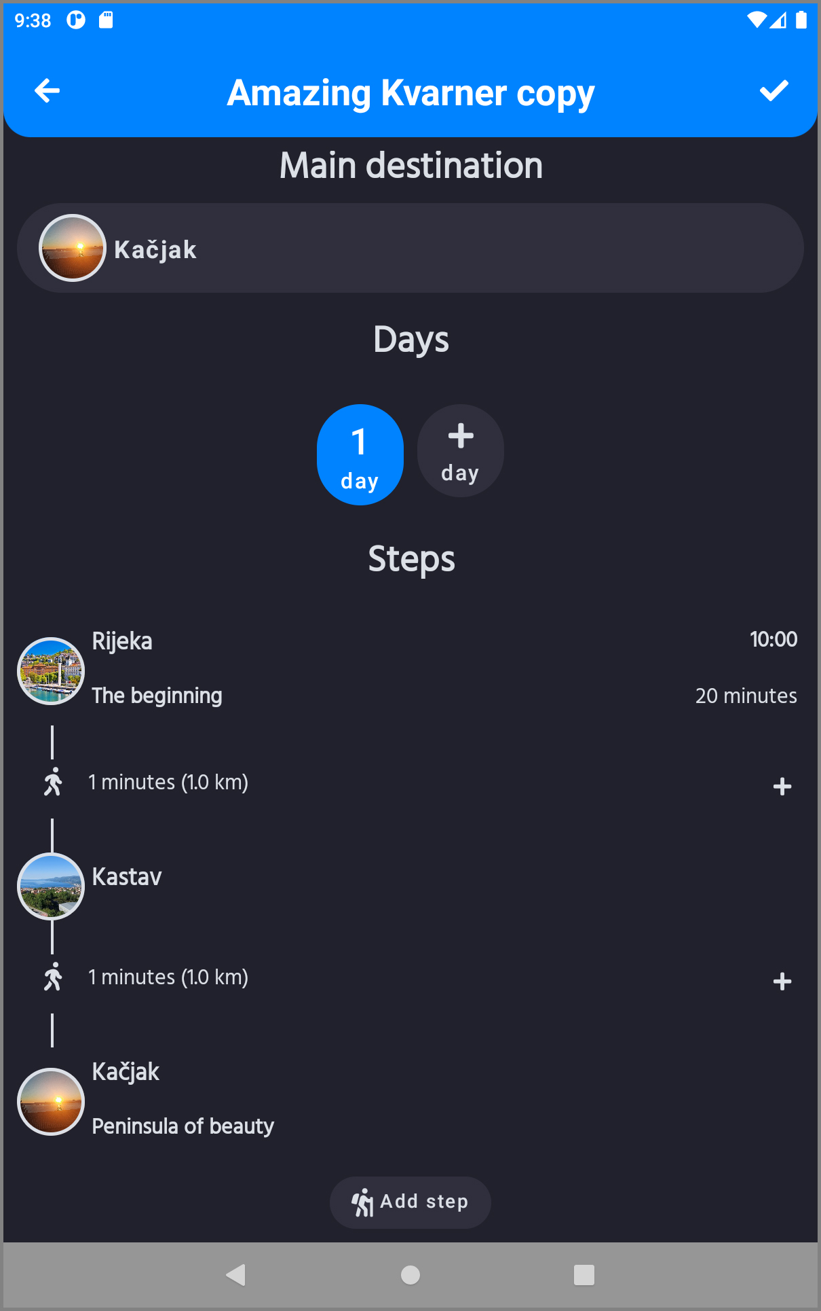
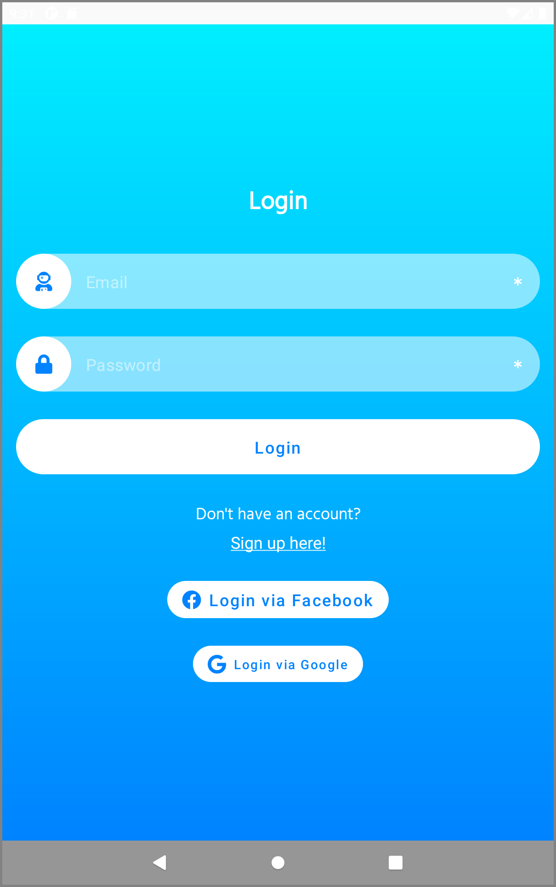
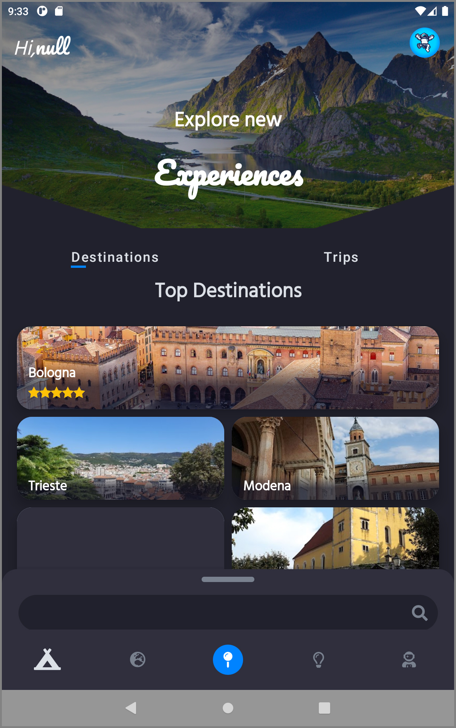
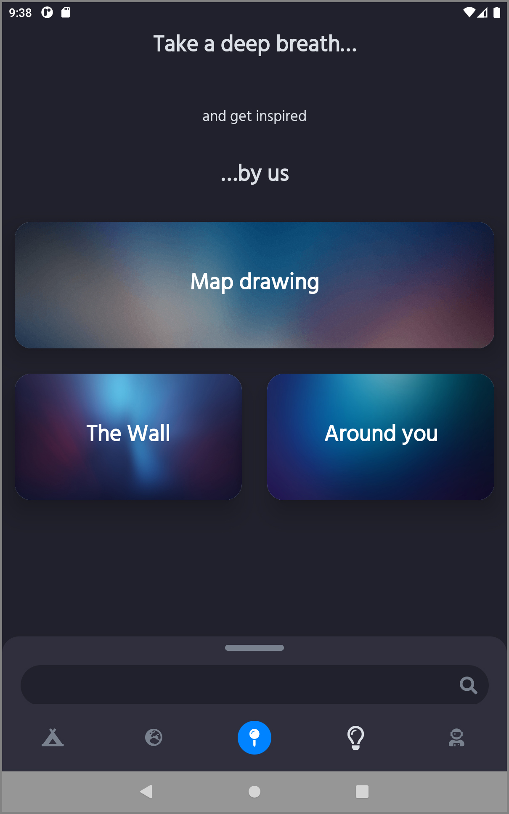
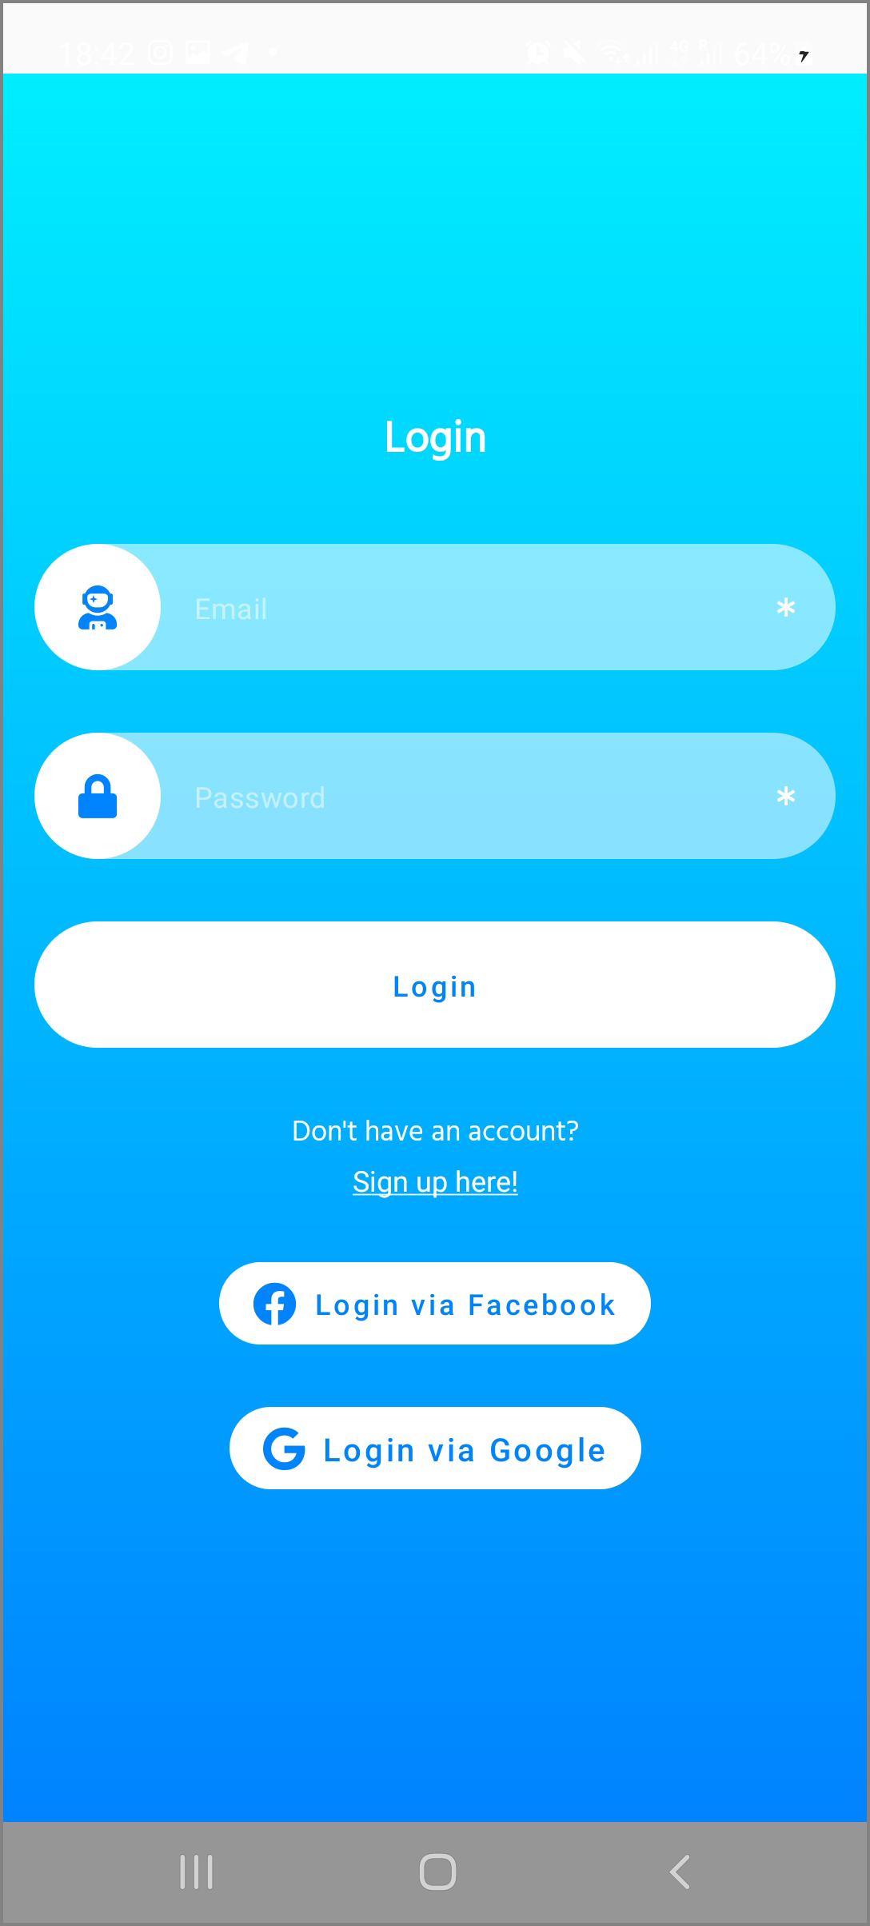
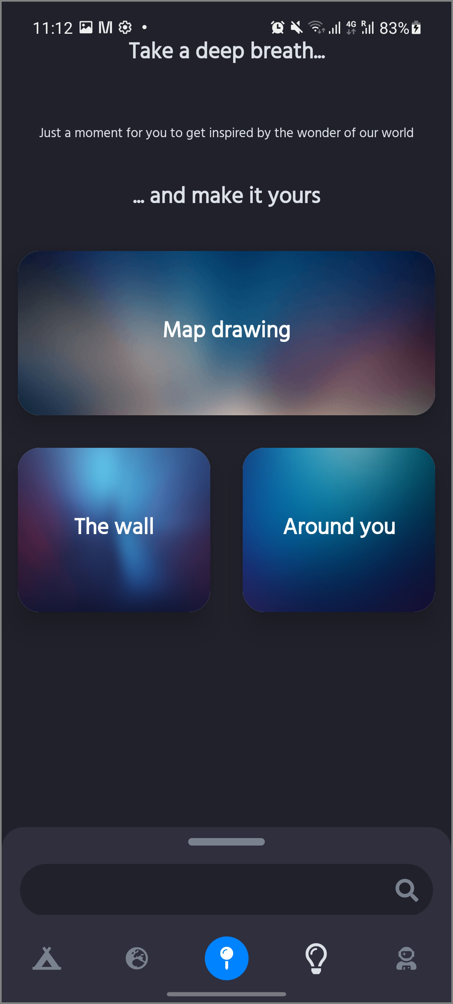
Device support
Supports only Android devices – more than 70% market share
Anroid API level 24 (Android 7.0)
Adjustable screen size support – mobile phones and tablets

Slide 13

THANK YOU FOR THE ATTENTION!

